Slide 1
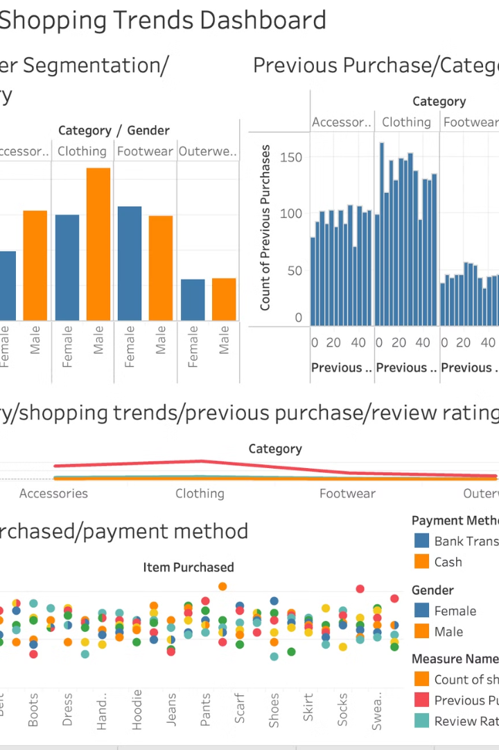
Retail Business Insights and Trends
Analysing shopping patterns and customer behaviour.
Presented by Youhem Rouainia.

Slide 2
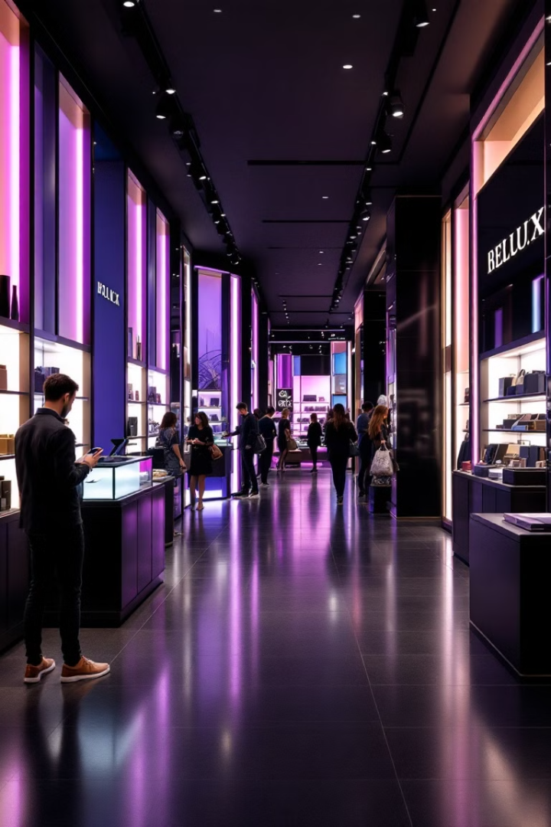
Introduction
1
Purpose
Overview of retail business trends.
2
Objective
Insights into customer preferences.

Slide 3
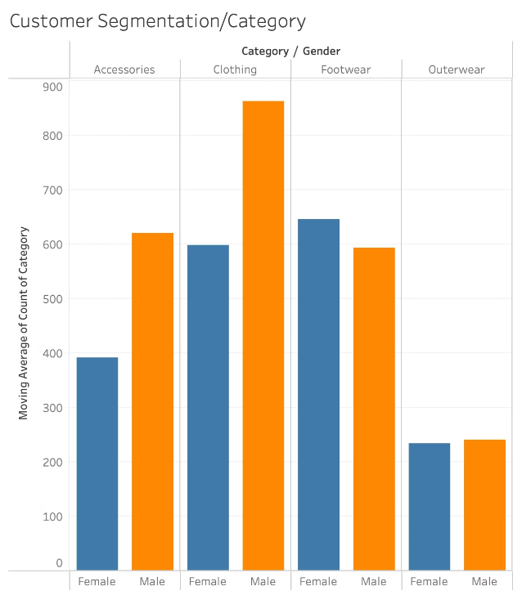
Customer Segmentation
Category Preferences
Preferences of male and female customers.
Categories popular among each gender.

Slide 4

Previous Purchase Analysis
Purchase Frequency
Frequency of purchases in each category.
Categories with highest repeat rates.

Slide 5
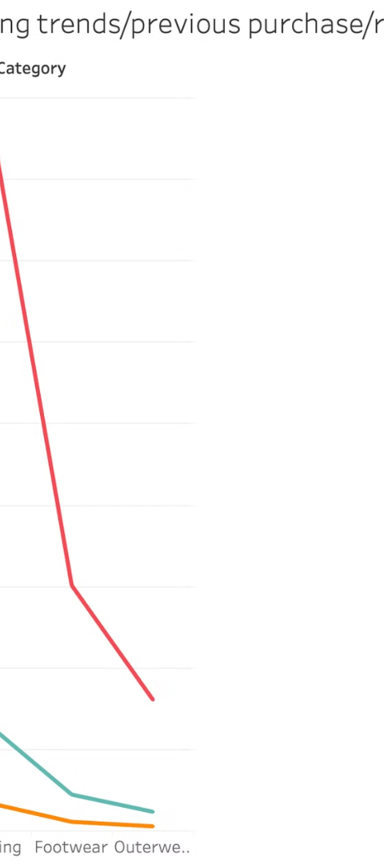
Category Trends
1
Overall Trends
Discuss the trends in different categories.
2
Review Influence
How reviews influence shopping trends.
3
Payment Methods
Payment methods correlation with items.

Slide 6




Seasonal Shopping Trends
Shopping Behaviour
Changes across different seasons.
Peak Times
Peak shopping times each season.
Popular Items
Popular items in each season.

Slide 7
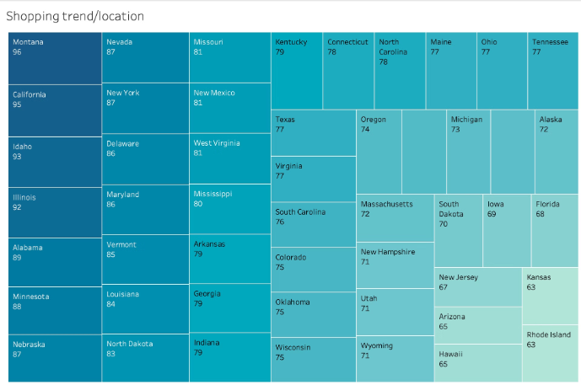



Geographical Shopping Trends
2
Shopping Variation
1
Trends vary by location.
3
High shopping activity regions.
Low shopping activity regions.

Slide 8

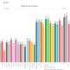

Product Category Trends by Gender
Purchasing Behaviour
Popular Items
Least Popular Items
Compare male and female customers.
Most popular items by gender.
Least popular items by gender.

Slide 9

Conclusion
Summary
Key insights and trends observed.
Recommendations
Targeted marketing strategies.
Inventory
Suggestions for inventory management.
Engagement
Customer engagement based on insights.

